Slide 1
SENTIMENT ANALYSIS ON TWITTER DATASETS

Slide 2
ABSTRACT:-
Twitter has become a major social media platform and has attracted considerable interest among researchers in sentiment analysis. Research into Twitter Sentiment Analysis (TSA) is an active subfield of text mining. TSA refers to the use of computers to process the subjective nature of Twitter data, including its opinions and sentiments. In this research, a thorough review of the most recent developments in this area, and a wide range of newly proposed algorithms and applications are explored. Each publication is arranged into a category based on its significance to a particular type of TSA method. The purpose of this survey is to provide a concise, nearly comprehensive overview of TSA techniques and related fields. The primary contributions of the survey are the detailed classifications of numerous recent articles and the depiction of the current direction of research in the field of TSA.

Slide 3
EXSISTING SYSTEM | PROPOSED SYSTEM
Due to the recent explosive rise of Social Networking Services (SNS), an enormous amount of user-generated data, such as comments and reviews, is being created consistently. People’s opinions and feelings are expressed in the information, which is mostly based on a common object of interest. These data have become treasure troves of information, giving several chances for analyzing people’s reactions, which is particularly beneficial in forecasting the sales of products, trends in the stock market, and results of political elections. There are more than 300 million active Twitter users [5], making it one of the most popular micro-blogging services. In light of its significance in the perception of people’s thoughts and attitudes, Twitter-based Sentiment Analysis (TSA) has consequently attracted a great deal of attention | In this research, a thorough review of the most recent developments in this area, and a wide range of newly proposed algorithms and applications are explored. Each publication is arranged into a category based on its significance to a particular type of TSA method. The purpose of this survey is to provide a concise, nearly comprehensive overview of TSA techniques and related fields. The primary contributions of the survey are the detailed classifications of numerous recent articles and the depiction of the current direction of research in the field of TSA.

Slide 4
EXISTING ALGORITHM sentiment analysis | PROPOSED ALGORITHM:- natural language processing
The chosen articles in the present survey have a significant impact on TSA research and related topics. Particularly, the state-of-the-art technologies available today have been incorporated to exhibit the most current findings of TSA, while the traditional approaches were selected as a comparative standard. In addition, the central section of the survey is structured with three primary components: machine-learning-based, lexicon-based, and hybrid approaches, all of which are in keeping with the current trends in TSA research. More effort has also been devoted to machine-learning-based solutions since those techniques can produce a better performance of prediction accuracy for TSA tasks. Specifically, TSA is extensively discussed in this survey, and it is broken down into the following subsections: Section 2 introduces the role and the structure of Twitter. Section 3 illustrates the background and basic concept of sentiment analysis. The representation of the feature for TSA is explained in Section 4, and Section 5 shows the different levels of analysis. In Section 6, the approaches and recent achievements in Twitter sentiment analysis are presented. | ALGORITHM DEFINITION:- Opinion mining is a subfield of linguistics and natural language processing that deals with sentiment analysis. It evaluates the degree of polarity of words and phrases to examine and extracts views and feelings from textual data. Various studies and advances have been carried out by organizations or individuals that are interested in finding out how people feel about a given issue. The term of sentiment was firstly coined by Das and Chen and Tong in 2001, who evaluated the sentiment of the market by automatic analysis of the text, and were some of the first to discuss sentiment analysis and the Natural Language Processing (NLP) methods that go along with it in their following publications. In addition, a great deal of work has been carried out on more application-oriented approaches. As an example, Liu et al. proposed a sentiment-based approach to forecast sale patterns. The models presented by to estimate product and merchant quality were statistical and heuristic. Used sentiment analysis techniques to find hidden relationships between subjects and opinionated phrases in the political realm, where novel opinion scoring models were developed. Yano and Smith [30] sought to identify links between the number of comments and political sentiment using statistical modelling. Furthermore, evaluating Twitter conversation has emerged as a promising area of study

Slide 5
DRAWBACKS:- | ADVANTAGES:-
The factors that affect the privacy decision in mobile and online photo sharing. The user-centric OSNs information sharing | So, to encourage more users to share information. In order to help users protect their private personal information

Slide 6
MINIMUMSYSTEM REQUIREMENTS
HARDWARE REQUIREMENTS
PROCESSOR : DUAL CORE 2 DUO.
RAM : 2GB DD RAM
HARD DISK : 250 GB
SOFTWARE REQUIREMENTS
FRONT END : J2EE (JSP, SERVLET)
BACK END : MY SQL 5.5
OPERATING SYSTEM : WINDOWS 7
IDE : ECLIPSE

Slide 7
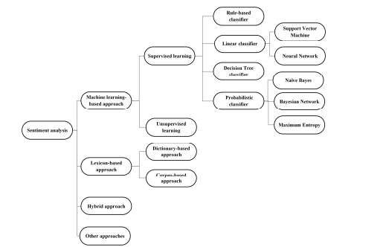
SYSTEM ARCHITECTURE

